Slide 1
Inverse Z Transform using Long Division Method

Slide 2
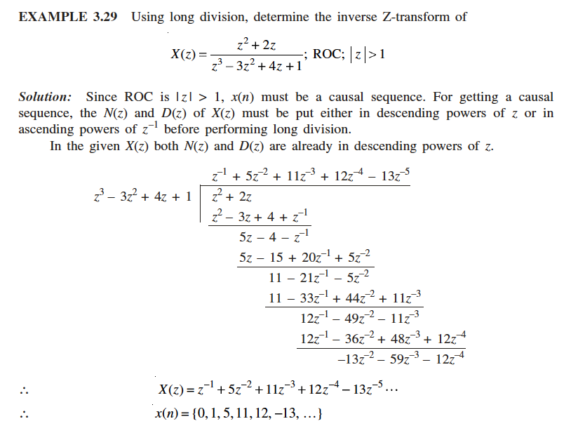

Slide 4
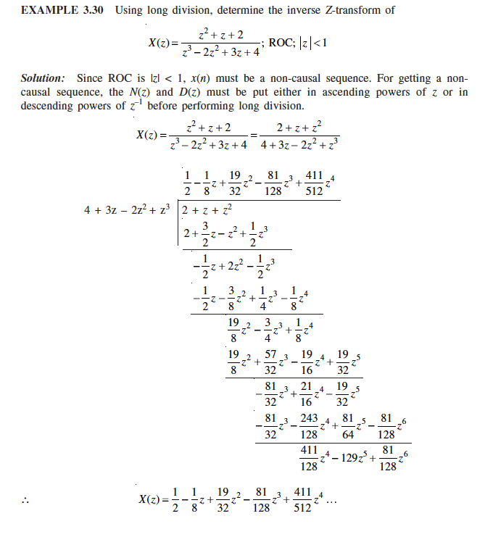

Slide 6


Slide 7
If all the poles of H(z) are inside the unit circle, then the system is said to be ____________
a) Only causal b) Only BIBO stable c) BIBO stable and causal d) None of the mentioned

Slide 8
c

Slide 9
Inverse Z Transform using Partial Fraction Expansion Method

Slide 10
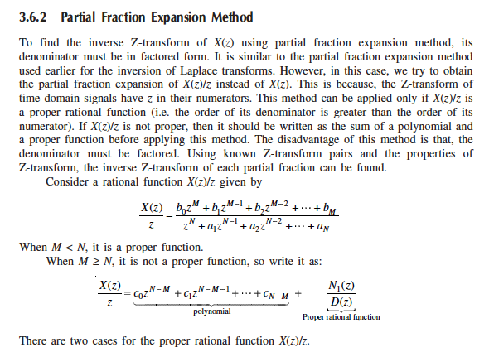

Slide 11
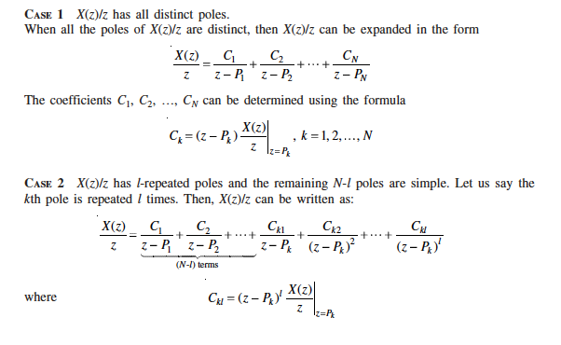

Slide 12
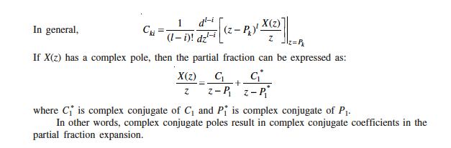

Slide 13
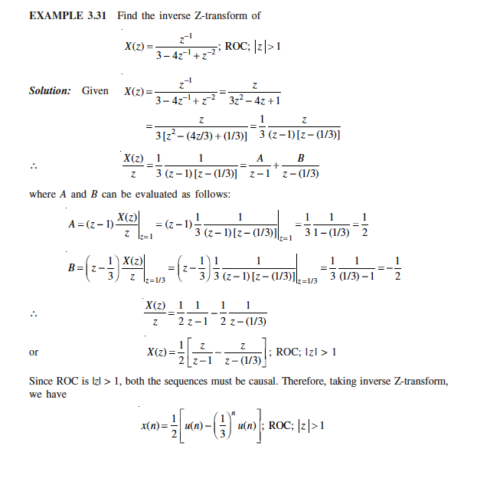

Slide 14
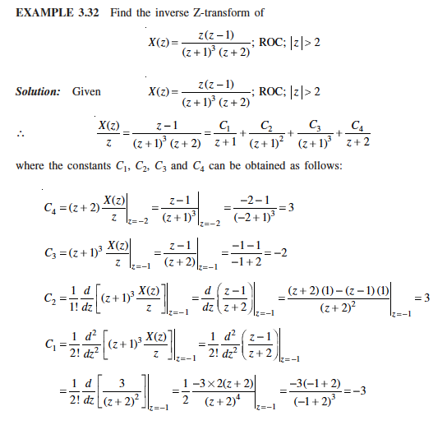

Slide 15
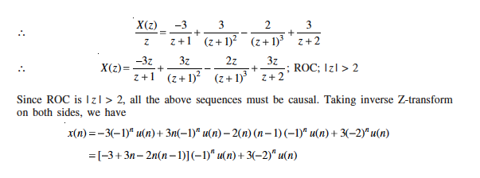

Slide 16
A linear time invariant system is characterized by the system function H(z)=1/(1−0.5𝑧⁻¹) + 2/(1−3𝑧⁻¹). What is the h(n) if the system is stable?
a) (0.5)^{n}u(n)-2(3)^{n}u(n) b) (0.5)^{n}u(-n-1)-2(3)^{n}u(n) c) (0.5)^{n}u(n)-2(3)^{n}u(-n-1) d) None of the above

Slide 17
Answer: c
Explanation: The system has poles at z=0.5 and at z=3. Since the system is stable, its ROC must include unit circle and hence it is 0.5<|z|<3 . Consequently, h(n) is non causal and is given as h(n)= (0.5)^{n}u(n)-2(3)^{n}u(-n-1).

Slide 18
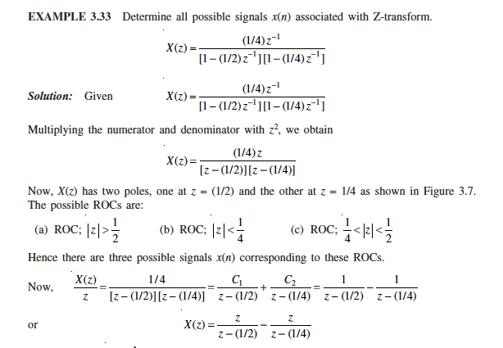

Slide 19
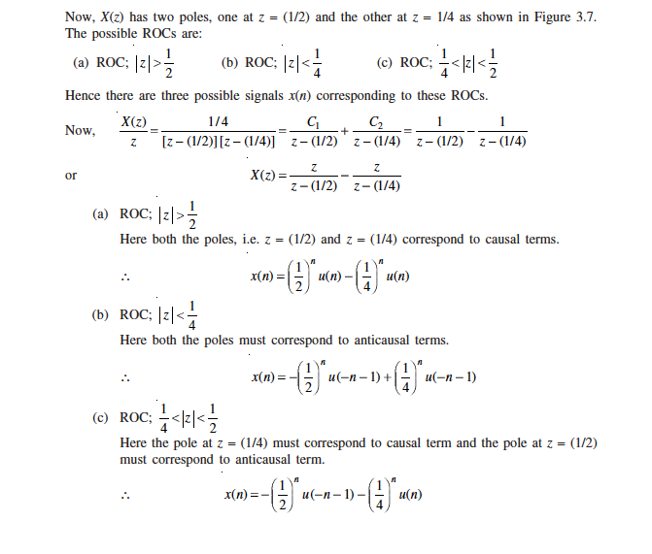

Slide 20
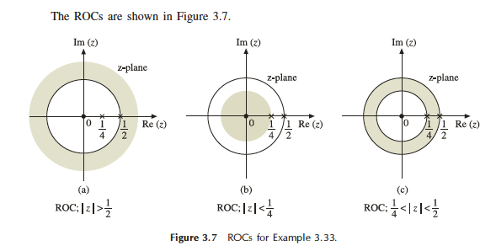

Slide 21
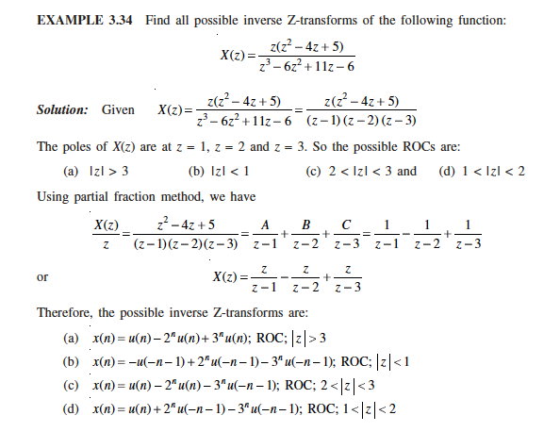

Slide 22
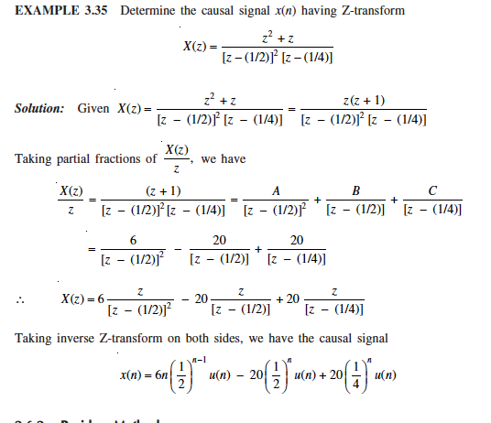

Slide 23
A linear time invariant system is characterized by the system function H(z)=1/(1−0.5𝑧⁻¹) + 2/(1−3𝑧⁻¹). What is the ROC of H(z) if the system is causal?
a) |z|<3 b) |z|>3 c) |z|<0.5 d) |z|>0.5

Slide 24
Answer: b Explanation: The system has poles at z=0.5 and at z=3. Since the system is causal, its ROC is |z|>0.5 and |z|>3. The common region is |z|>3. So, ROC of given H(z) is |z|>3.

Slide 25
A linear time invariant system is characterized by the system function H(z)=[1/(1−0.5𝑧⁻¹)] + [2/(1−3𝑧⁻¹)] What is the h(n) if the system is anti causal?
a) (0.5)^{n}u(n)+2(3)^{n}u(n) b) (0.5)^{n}u(-n-1)-2(3)^{n}u(-n-1) c) -[(0.5)^{n}+2(3)^{n}]u(-n-1) d) (0.5)^{n}u(n)-2(3)^{n}u(-n-1)

Slide 26
c
Answer: c Explanation: The system has poles at z=0.5 and at z=3. If the system is anti causal, then the ROC is |z|<0.5.Hence h(n)= -[(0.5)^{n}+2(3)^{n}]u(-n-1).

